Slide 1
GEOL 840 — Satellite Detection of Algal Blooms -- WEEK 1 Update Sep 25
Research Objective
Identify documented algal-bloom events in Severn Sound/Georgian Bay.
Determine whether these events can be observed using freely available Sentinel-2 imagery.
Assess which spectral indicators are useful and what limits satellite detection.
Approach: Documented bloom → Satellite imagery → Spectral indices → Ground-truth validation.
Built a Google Earth Engine workflow using Sentinel-2.
Applied water and brightness masks to reduce false signals.
Manually screened imagery and selected only clear, usable dates. 2023-07-10 to 2023-09-03 (5 of 5)
Calculated multiple indices: NDCI (chlorophyll), CIcyano (cyanobacteria), FAI (floating algae), NDTI (turbidity), NDVI (biomass).
Used multi-date median index mosaics and point-based comparisons.
Midland 2023, Severn Sound:
Focused on the documented Midland Bay/Severn Sound event.
Identified 5 manually verified clear Sentinel-2 dates: July 10, August 9, August 19, August 29, September 3, 2023.
Compared 3 Midland Bay locations with an open-basin reference point.
Current results show a persistent difference between bay and open-basin NDCI values.
The observed signal is weaker than the strong Baltic Sea reference bloom.
Some apparent signals were identified as likely dark-water, shoreline, or atmospheric/cloud effects.
Baltic Sea, Positive Reference
Used a documented Nodularia spumigena bloom (August 2015) as a positive reference.
Sentinel-2 produced a strong spectral response within a visible bloom filament.
NDCI reached approximately 0.31 at a sampled bloom location.
A nearby location outside the filament showed little/no comparable signal.
Demonstrates the importance of spatially localized ground/reference observations.

Slide 2
What I Have Learned
Colour maps alone can exaggerate small differences.
Multi-point numerical measurements are more reliable than visual interpretation alone.
Dark, clear water can produce unstable ratio-index values.
Cloud/cirrus contamination can create apparent biological signals.
Shoreline effects can produce persistent FAI/NDVI patterns unrelated to an actual bloom.
Satellite detection therefore requires careful image screening and independent validation.
Next Week
Literature review
  Verify published index formulations and thresholds.
  Establish how NDCI, CIcyano, FAI, NDTI and NDVI should be interpreted.
Ground-truth data
  Contact the relevant research/monitoring group for samples, locations, measurements and photographs. In this case I was wondering if you can direct me to proper POCs.
Expand event analysis
  Apply the workflow to Tay 2021 and Penetang 2022.
Complete Sentinel-1 SAR analysis
  Examine SAR observations together with wind conditions.
Assess detection limits
  Determine when Sentinel-2 can reliably distinguish bloom signals from turbidity, shoreline effects, atmospheric contamination and normal water variability.
Overall Research Question: Under what conditions can freely available satellite imagery reliably detect and characterize algal blooms in Severn Sound?

Slide 3
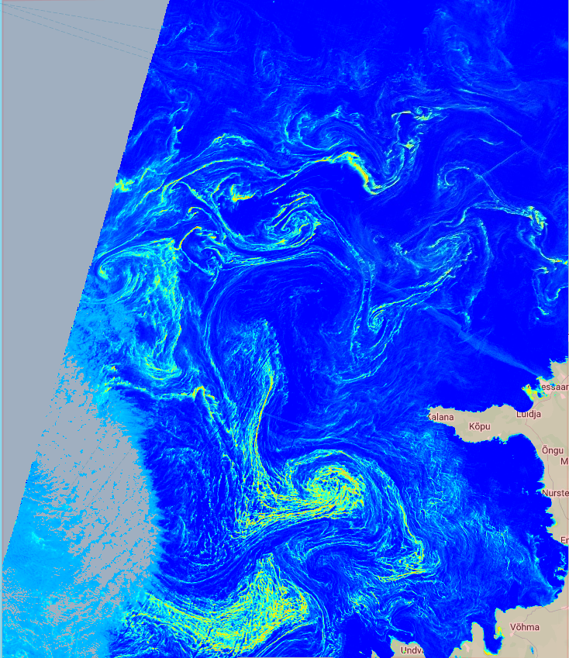
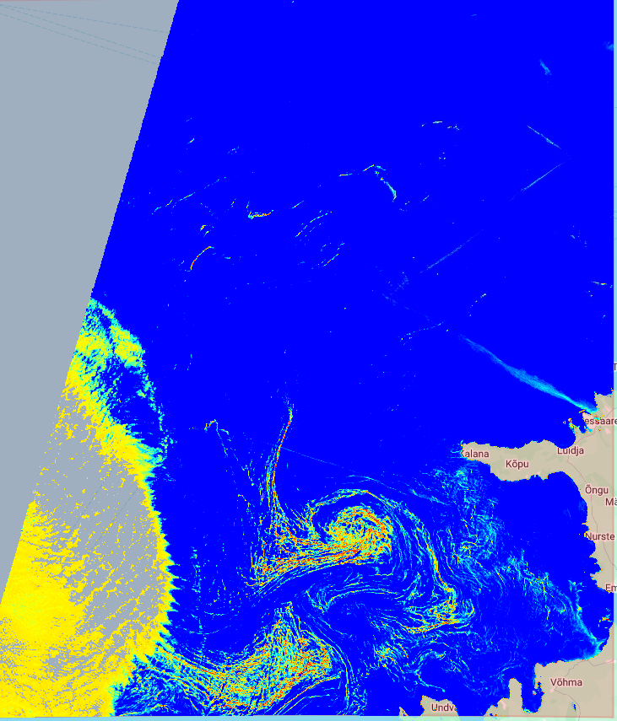
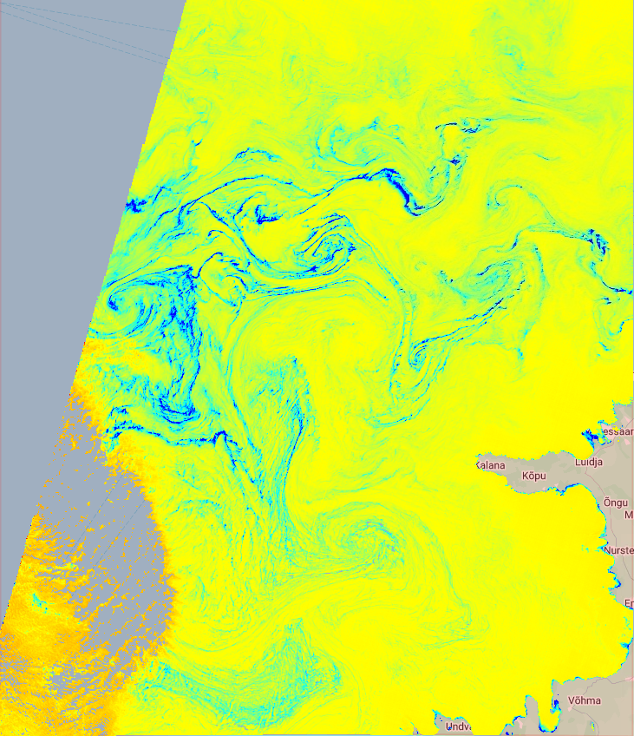
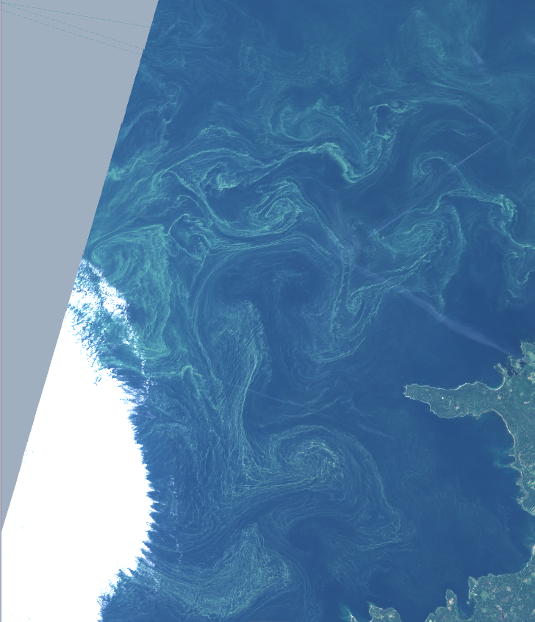
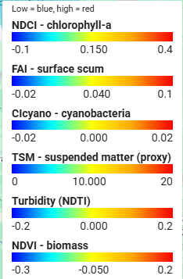
Baltic Sea Algae Bloom, Aug 2015
NCDI-Chlorophyll
NDVI-Biomass
CIcyano-Cynobacteria
True Color

Slide 4
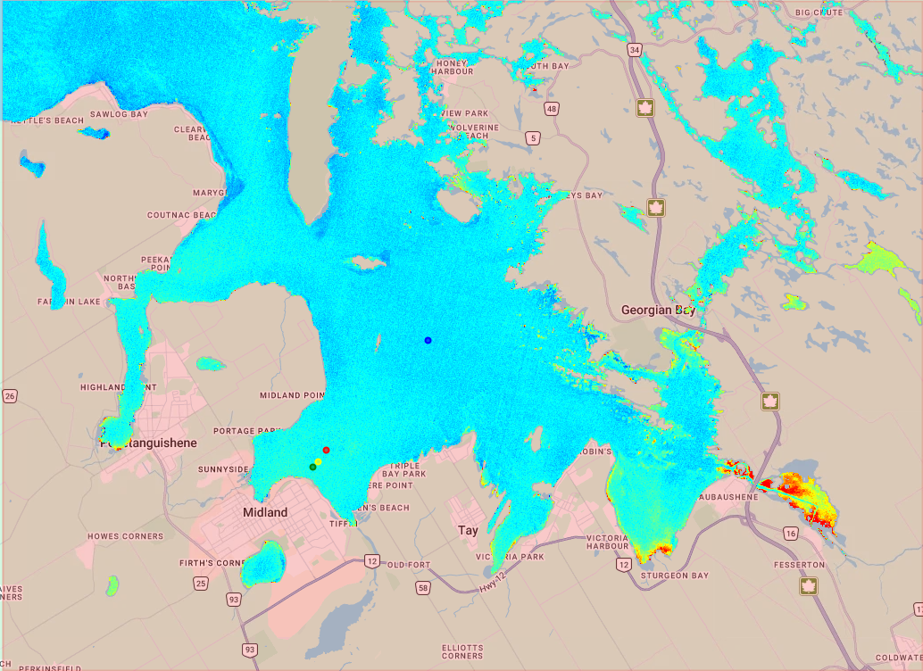
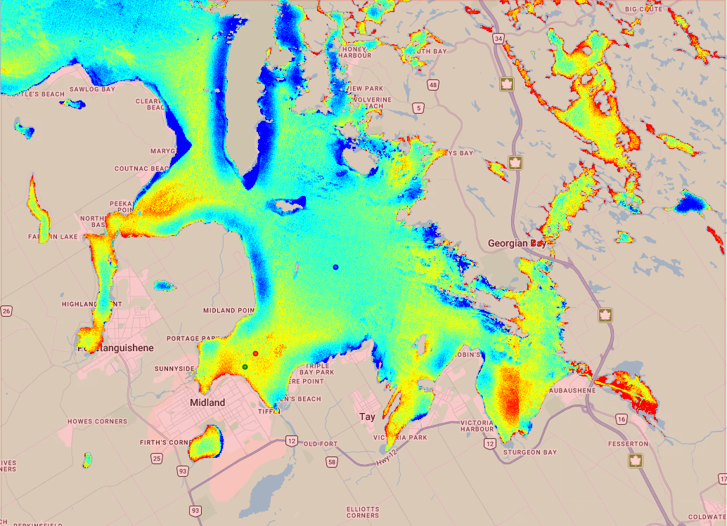
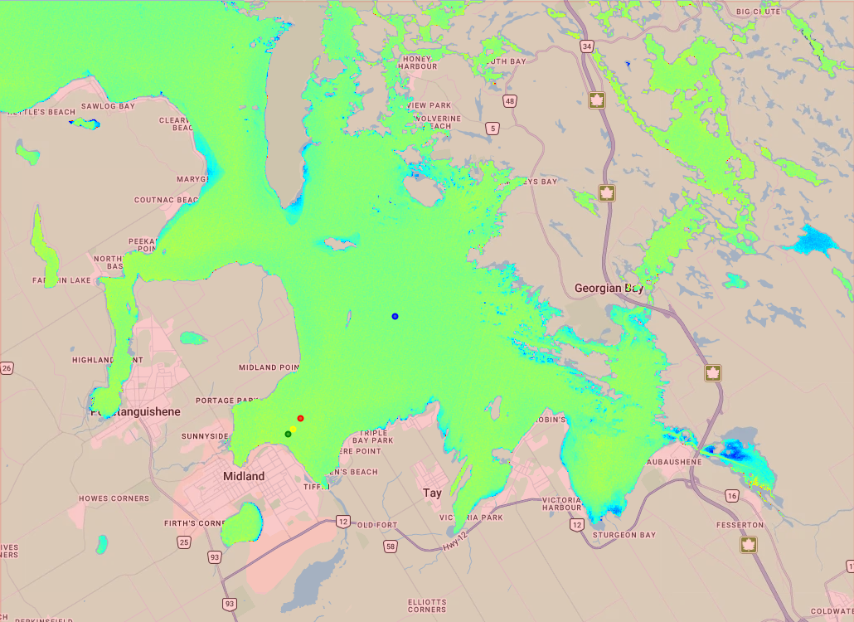
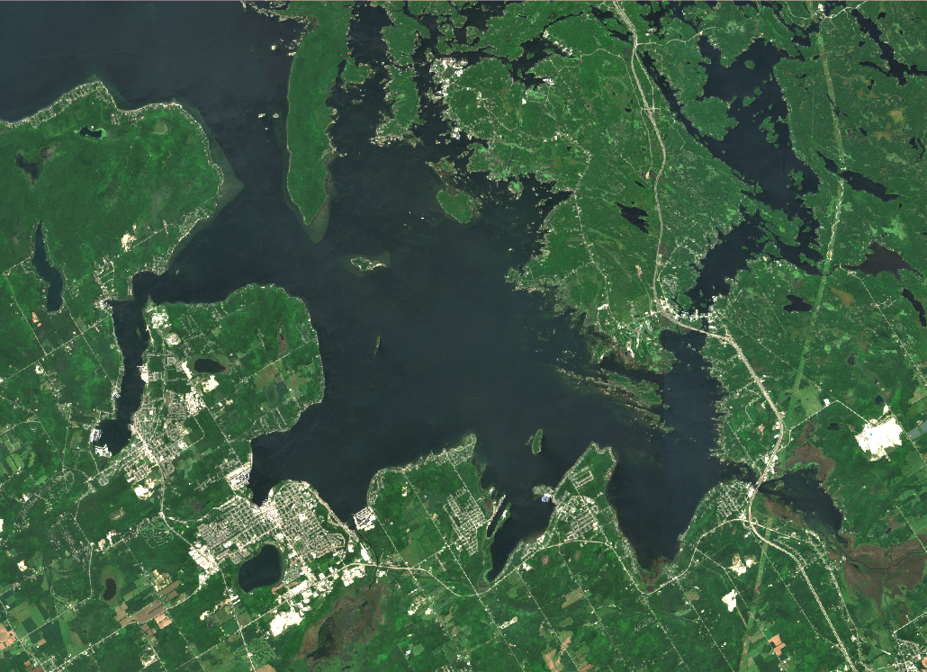
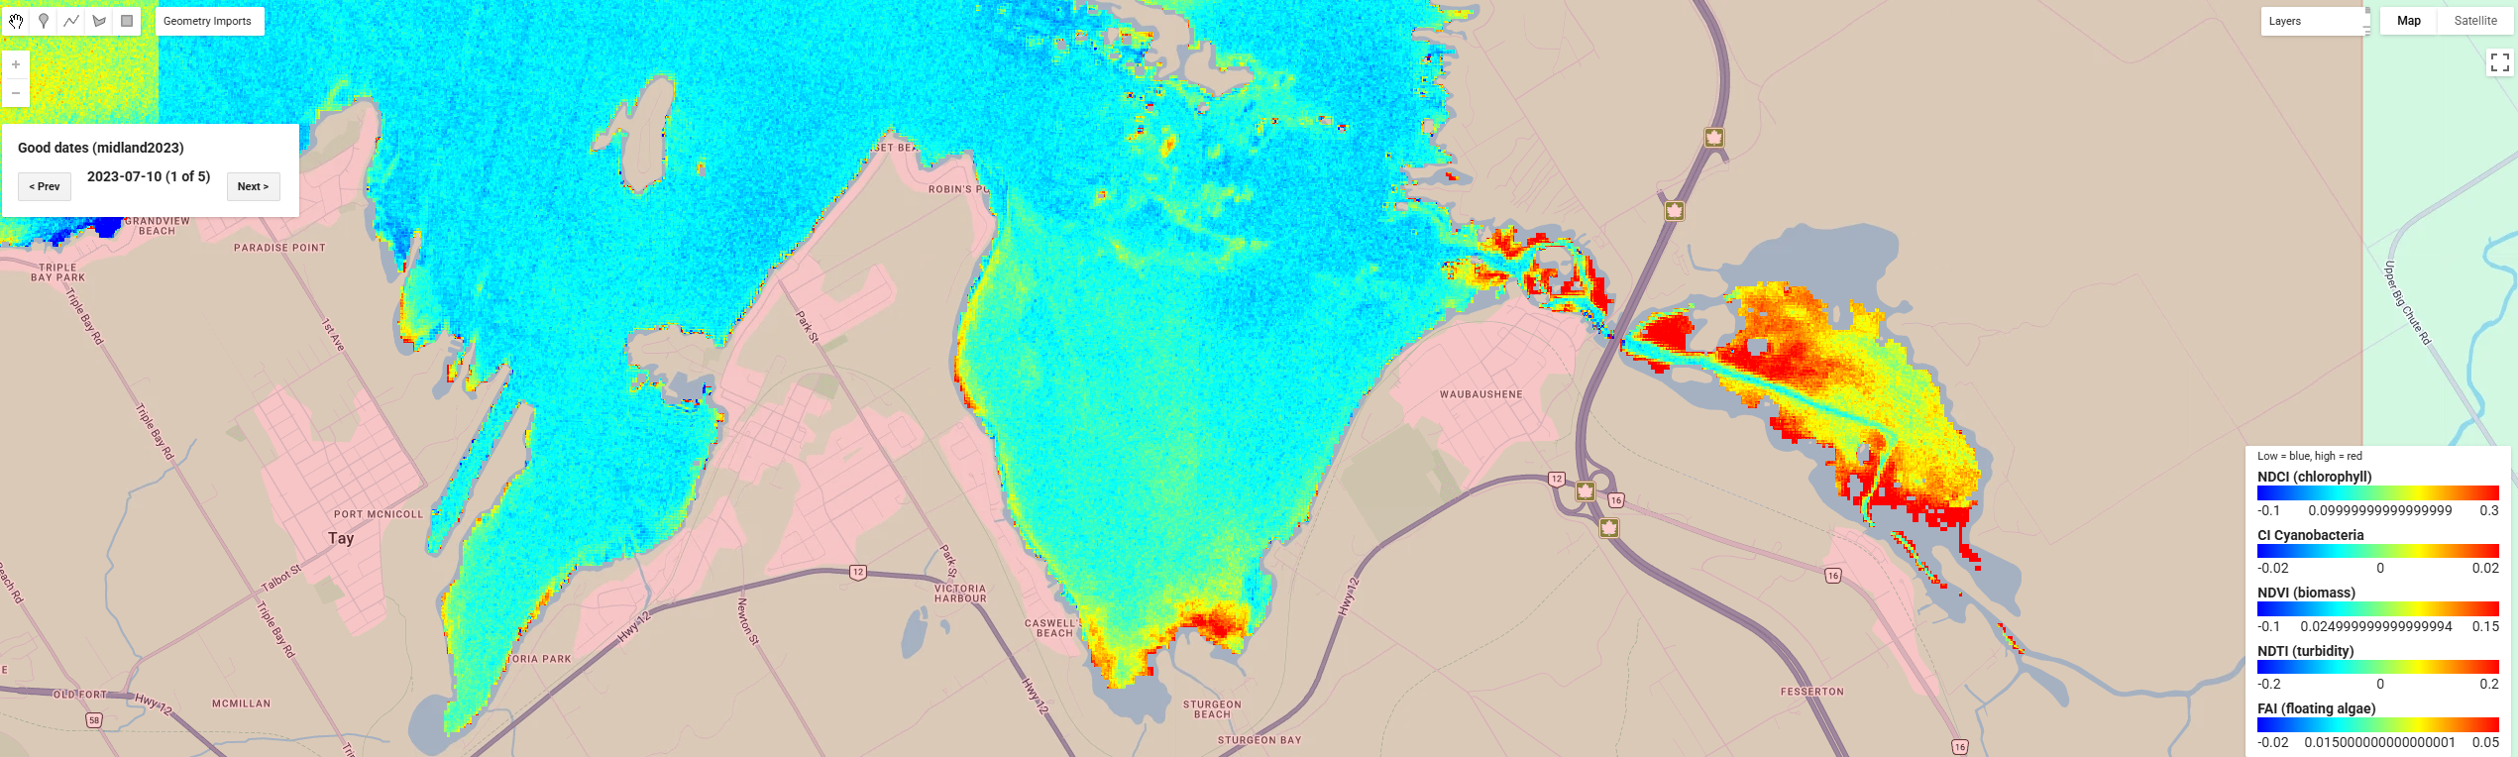
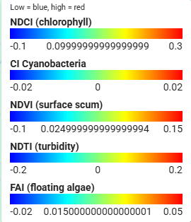
Georgian Bay Algae Bloom, July-Aug 2022, 5 good day medians
NCDI-Chlorophyll
NDVI-Biomass
CIcyano-Cynobacteria
True Color
Zoomed in NCDI

